Slide 1
Paleomagnetic analysis of bimodal magmatism associated with Tule Tank Crater, San Francisco Volcanic Field, northeastern Arizona
Christina Turpin
Dr. Michael Ort
Northern Arizona University, Department of Geology

Slide 2
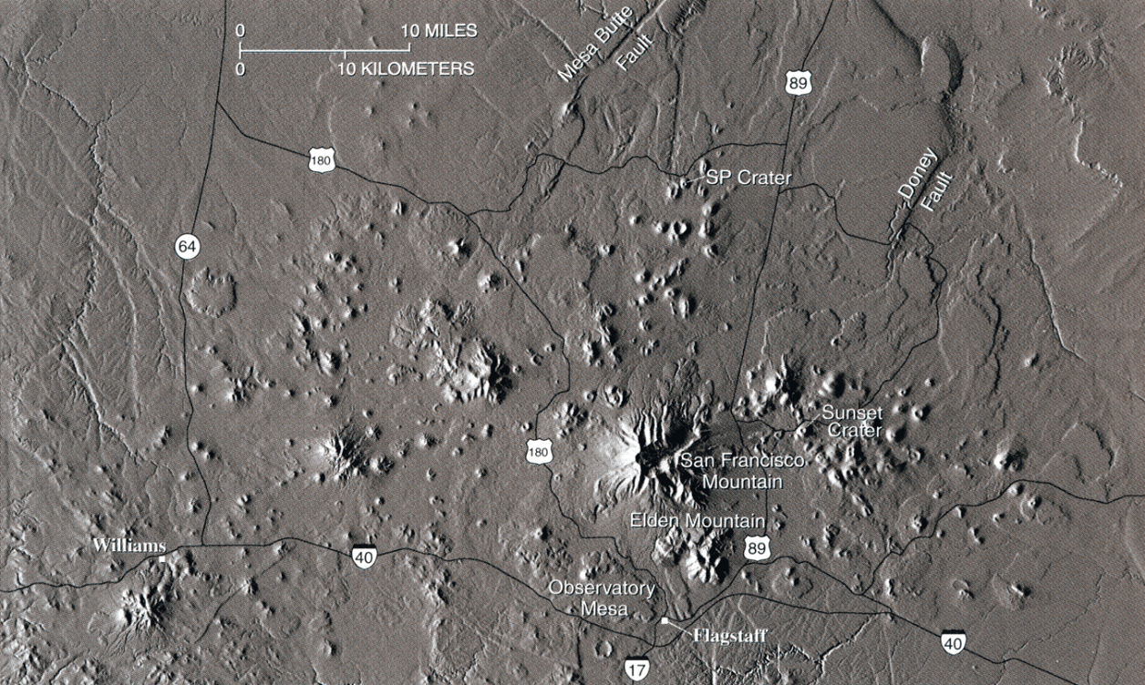
Background
San Francisco Volcanic Field (SFVF)
Notes:
SFVF
Colorado Plateau
600+ cinder cones – primarily basalt
Youngest eruptions are SP, Doney, Strawberry, Merriam, and Sunset, probably in that order

Slide 3
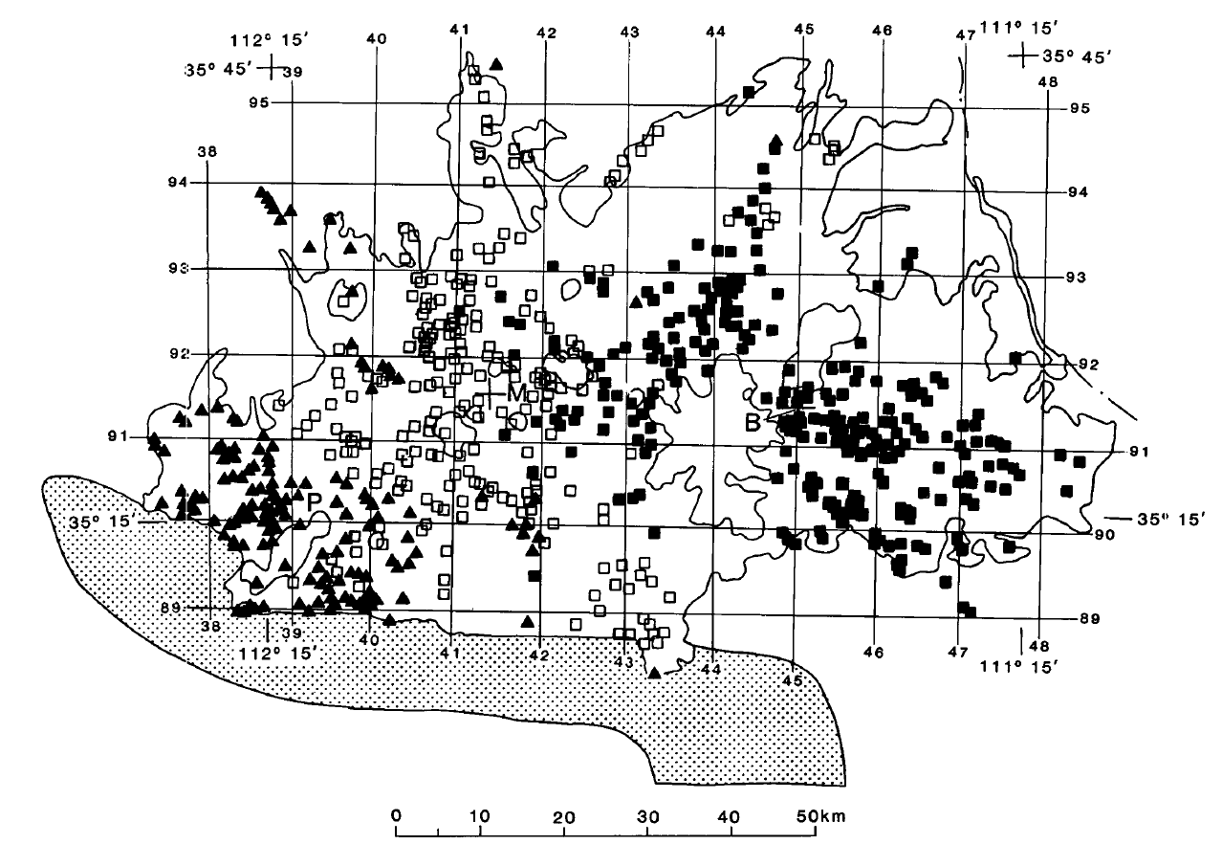
Research
Tule Tank Crater
Pre-Matuyama (+2.6 Ma)
Matuyama (2.6 Ma – 800 ka)
Brunhes (800 ka - Present)
Notes:
Matuyama – reversed polarity
Northeastward migration of the SFVF (chronozones)
Erupted benmoreite and rhyolite (dome)
Co-eval lava eruption?
If erupted simulataneously, their remanence should be identical.
Paleomagnetism used to time volcanic events
Paleomagnetism – orientation of magnetic remanence in rocks
Paleosecular variation – path that Earth’s magnetic poles travel over time
Comparison of remanence to secular variation facilitates age comparison

Slide 4
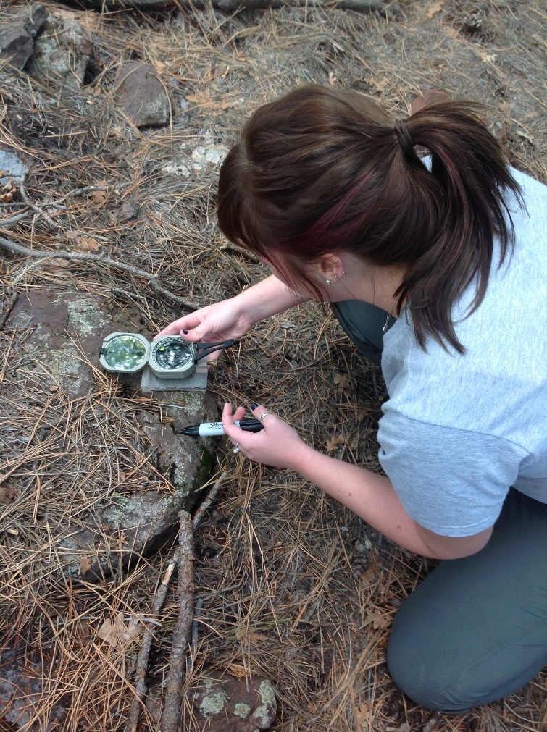
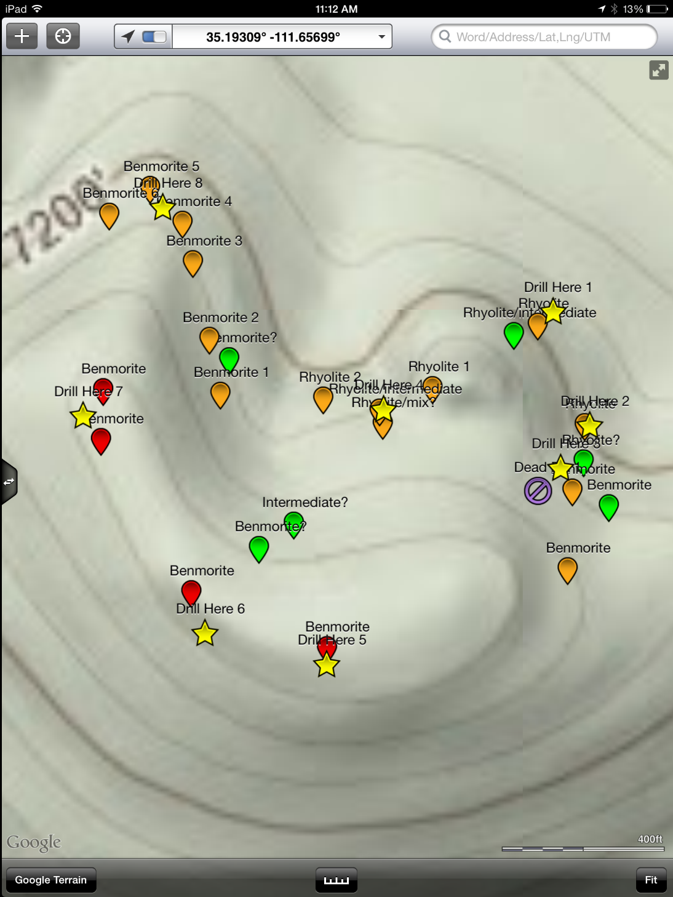
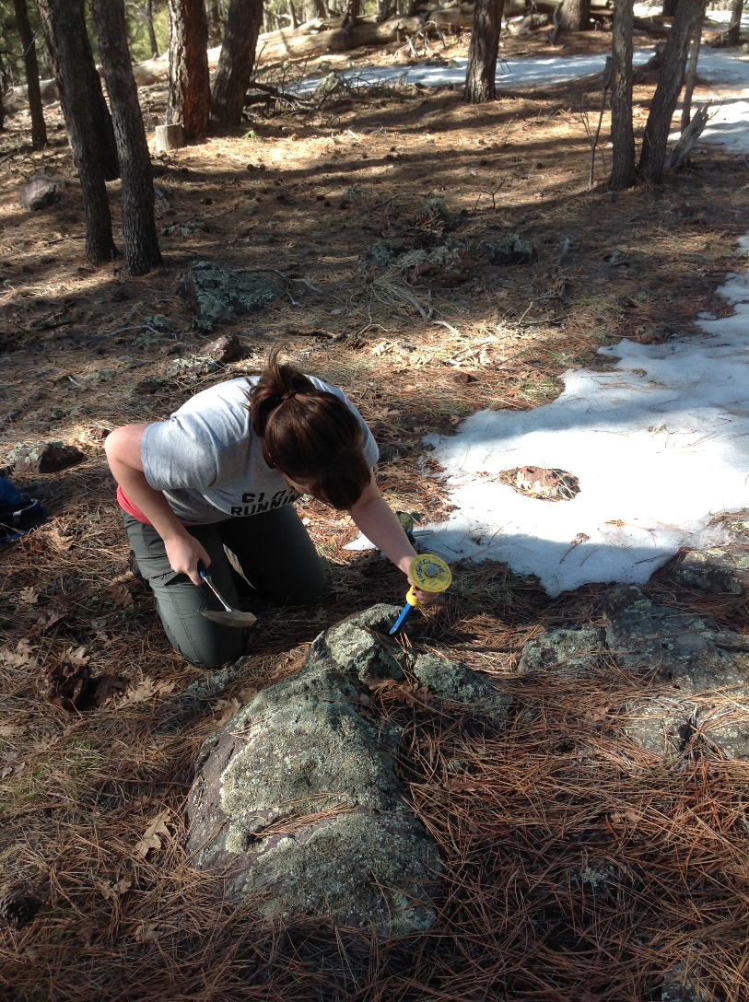
Methods
Field Work
Sample Collection >
< Tule Tank
Notes:
Research encompassed both field and lab work
Field:
Used GIS application to determine sample sites (stars depict sample sites)
Collected oriented samples by marking North at present and marking horizontal plane of sample

Slide 5
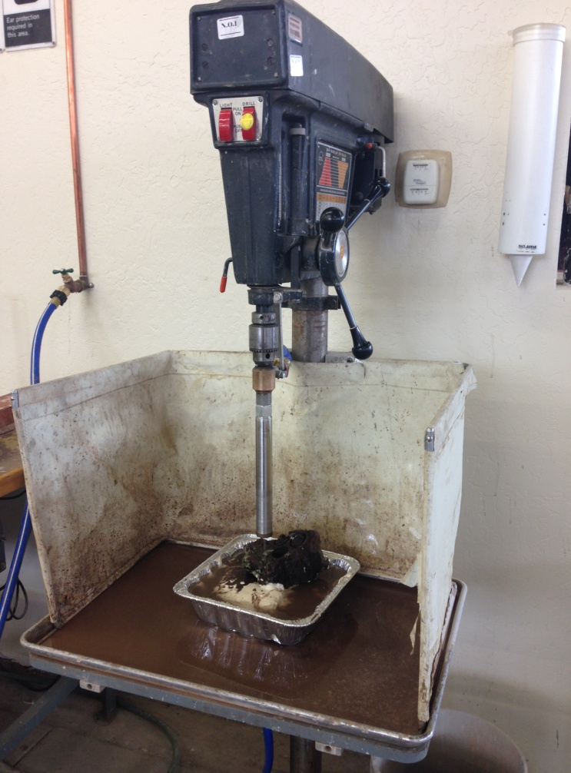
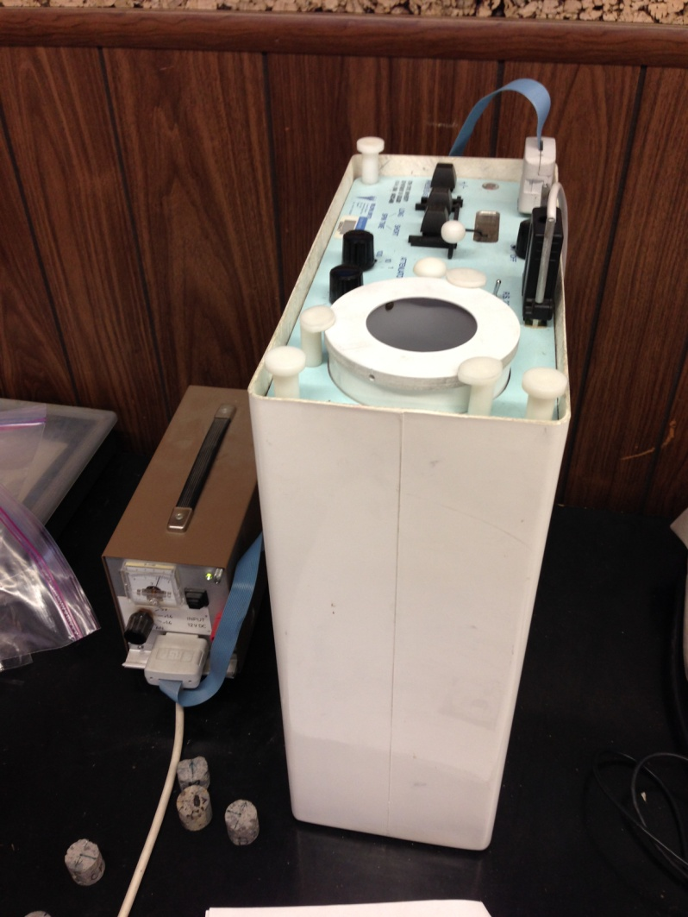
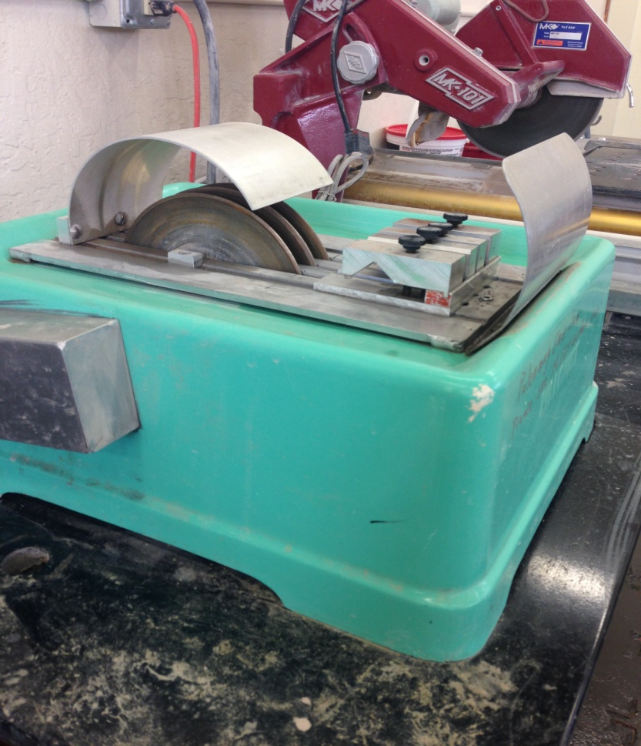
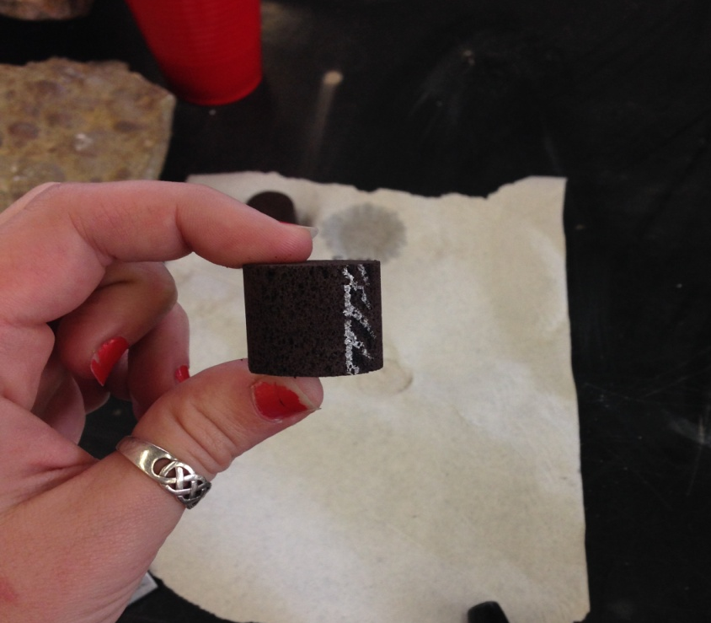
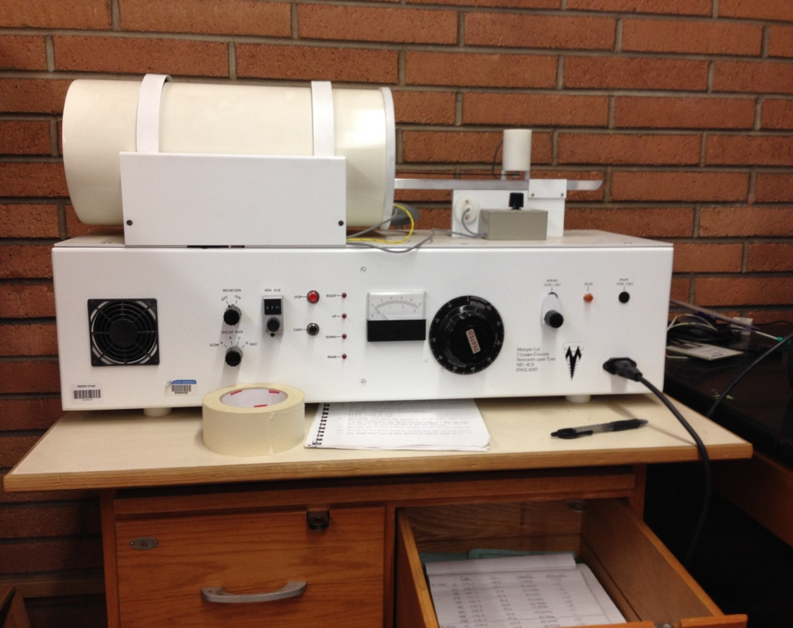
Lab Work
Set in Plaster
Drill
Cut
Process
Notes:
Samples collected in the field were cored and processed in paleomagnetism and demagnetizer machines
Puffinplot was used to process the data from the cores

Slide 6
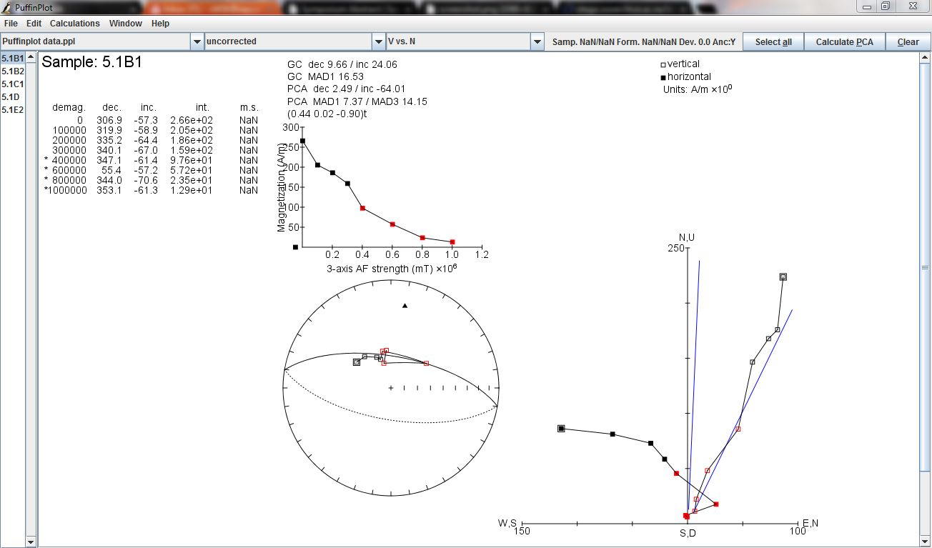
Data Analysis
Notes:
Example of one core within raw data of one site
The curve and stereonets shows the removal of remanent magnetism

Slide 7
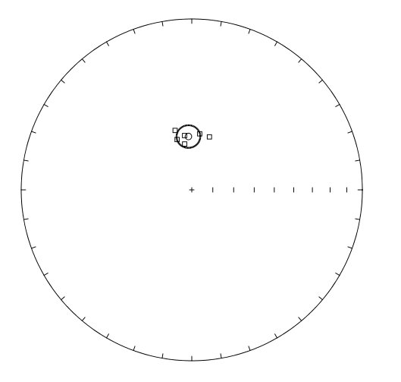
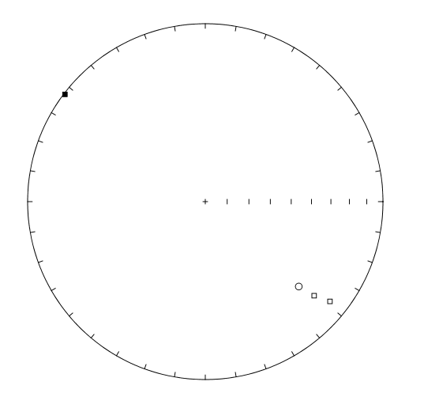
Results
Benmoreite
Modern magnetic field
Site 5.1
Site 10
Notes:
Not similar plots
Site 10 has more variation and not as well grouped as 5.1

Slide 8
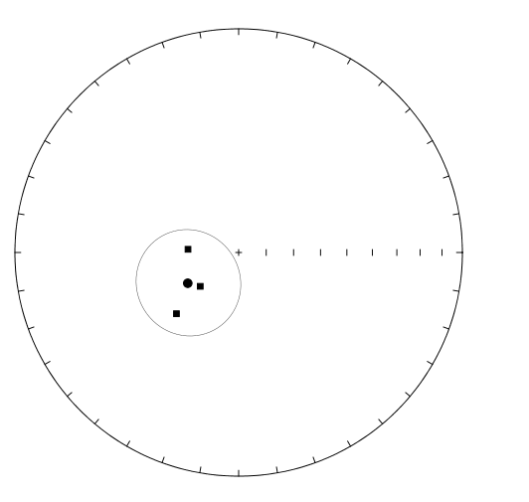
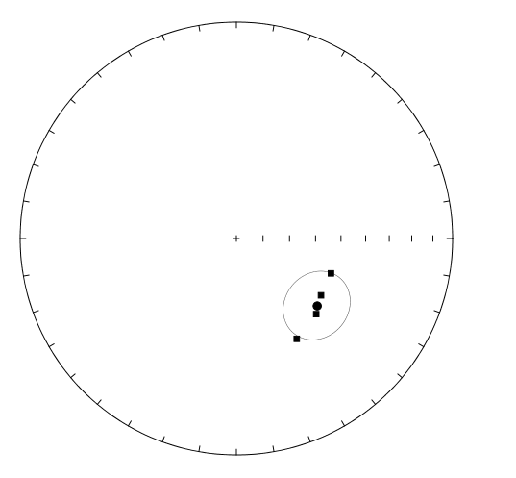
Results
Rhyolite
Modern magnetic field
Site 8.2
Site 1.3
Notes:
Plots again, do not appear similar, but may be within error of each other – need to do statistical analysis to be sure
Data say that they are not the same, but so scattered and so little data that they may be similar.

Slide 9
Conclusions
Preliminary data show some consistencies with Matuyama age of eruption
Alteration of samples’ magnetization has likely occurred
Further analysis is needed before conclusions are interpreted
Notes:
The data analyzed thus far are not consistently well grouped
causes for variation:
Lightning strike over 800,000 years ago (Rhyolite)
Lightning strike recent (Benmoreite)
Fire/Thermal alteration that we did not remove (vegetated area)
Chemical alteration of minerals can affect remanent magnetism
Problems with orientation
Paleomagnetic analysis is not always cut and dry
Further analysis is need before conclusions can be reached – more data

Slide 10
Acknowledgements
Dr. Michael Ort,
Dr. Nadine Barlow and Kathleen Stigmon,
NAU/NASA Space Grant, and
Arizona Space Grant Consortium
for allowing me this research opportunity!!

Slide 11
Questions?
Transporting samples out of a very snowy field site

